Slide 1
Lecture
Beginning HTML

Slide 2
Early Internet Navigation
Prior to 1989, users employed text-based UNIX commands to navigate the various resources on the WAN
Archie, Gopher, Veronica and Jughead three standard "finding" tools on the Internet.
Used Telnet to contact servers
Cumbersome, complex UNIX tools
Notes:
1989: Tim Berners-Lee invents the Web with HTML as its publishing language
The World Wide Web began life in the place where you would least expect it: at CERN, the European Laboratory for Particle Physics in Geneva, Switzerland. CERN is a meeting place for physicists from all over the world, where highly abstract and conceptual thinkers engage in the contemplation of complex atomic phenomena that occur on a minuscule scale in time and space. This is a surprising place indeed for the beginnings of a technology which would, eventually, deliver everything from tourist information, online shopping and advertisements, financial data, weather forecasts and much more to your personal computer.
Tim Berners-Lee is the inventor of the Web. In 1989, Tim was working in a computing services section of CERN when he came up with the concept; at the time he had no idea that it would be implemented on such an enormous scale. Particle physics research often involves collaboration among institutes from all over the world. Tim had the idea of enabling researchers from remote sites in the world to organize and pool together information. But far from simply making available a large number of research documents as files that could be downloaded to individual computers, he suggested that you could actually link the text in the files themselves.
In other words, there could be cross-references from one research paper to another. This would mean that while reading one research paper, you could quickly display part of another paper that holds directly relevant text or diagrams. Documentation of a scientific and mathematical nature would thus be represented as a `web' of information held in electronic form on computers across the world. This, Tim thought, could be done by using some form of hypertext, some way of linking documents together by using buttons on the screen, which you simply clicked on to jump from one paper to another. Before coming to CERN, Tim had already worked on document production and text processing, and had developed his first hypertext system, `Enquire', in 1980 for his own personal use.
Tim's prototype Web browser on the NeXT computer came out in 1990.

Slide 3
HTML – Invented 1989
Hypertext Markup Language
The “language” used to create web pages and web sites
Invented/written by Tim Berners-Lee at CERN, Geneva Switzerland.
Pioneered the concept of “linking” the text in files to other files.
Notes:
1989: Tim Berners-Lee invents the Web with HTML as its publishing language
The World Wide Web began life in the place where you would least expect it: at CERN, the European Laboratory for Particle Physics in Geneva, Switzerland. CERN is a meeting place for physicists from all over the world, where highly abstract and conceptual thinkers engage in the contemplation of complex atomic phenomena that occur on a minuscule scale in time and space. This is a surprising place indeed for the beginnings of a technology which would, eventually, deliver everything from tourist information, online shopping and advertisements, financial data, weather forecasts and much more to your personal computer.
Tim Berners-Lee is the inventor of the Web. In 1989, Tim was working in a computing services section of CERN when he came up with the concept; at the time he had no idea that it would be implemented on such an enormous scale. Particle physics research often involves collaboration among institutes from all over the world. Tim had the idea of enabling researchers from remote sites in the world to organize and pool together information. But far from simply making available a large number of research documents as files that could be downloaded to individual computers, he suggested that you could actually link the text in the files themselves.
In other words, there could be cross-references from one research paper to another. This would mean that while reading one research paper, you could quickly display part of another paper that holds directly relevant text or diagrams. Documentation of a scientific and mathematical nature would thus be represented as a `web' of information held in electronic form on computers across the world. This, Tim thought, could be done by using some form of hypertext, some way of linking documents together by using buttons on the screen, which you simply clicked on to jump from one paper to another. Before coming to CERN, Tim had already worked on document production and text processing, and had developed his first hypertext system, `Enquire', in 1980 for his own personal use.
Tim's prototype Web browser on the NeXT computer came out in 1990.

Slide 4
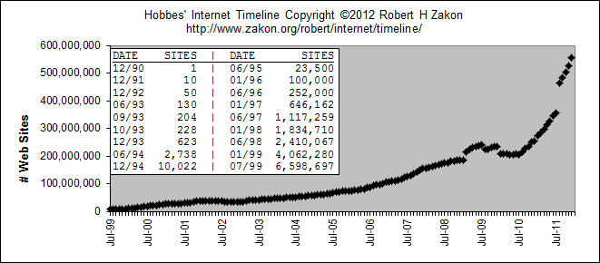
HTML
Governed by W3C
Been through various “versions”
Figure: WWW Growth

Slide 5
Web Browsers
HTML relies on Browsers
Software used to interpret HTML code and display the formatted page
It’s the “job” of the browser to translate the code
Also runs special programming like Java and JavaScript

Slide 6
Web Browsers
Available for a variety of Operating Systems and Hardware:
  Internet Explorer, Safari, AOL Browser, Netscape, Opera, Firefox
HTML pages are cross-platform:
  Windows, MacOS, Linux, Mobile Devices...
Various browsers don’t always interpret code the same way

Slide 7
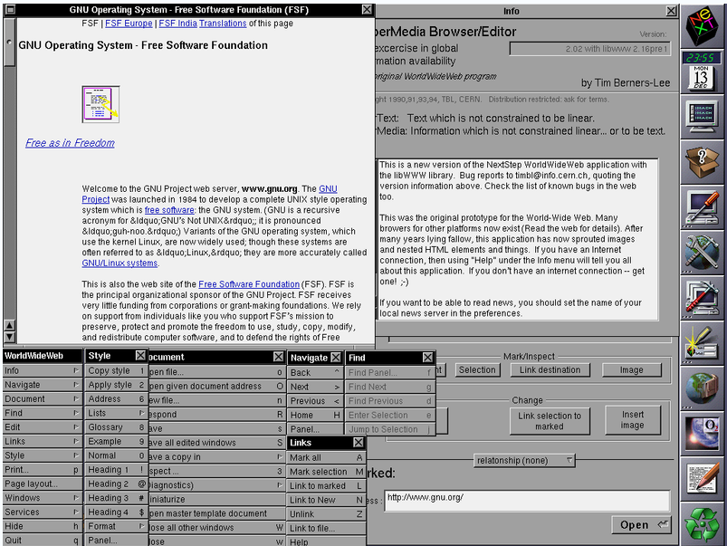
1991:First Web Browser
Notes:
Next, Inc. (later Next Computer, Inc. and Next Software, Inc. and stylized as NeXT) was an American computer company headquartered in Redwood City, California, that developed and manufactured a series of computer workstations intended for the higher education and business markets. NeXT was founded in 1985 by Apple Computer co-founder Steve Jobs after his forced resignation from Apple. NeXT introduced the first NeXT Computer in 1988, and the smaller NeXTstation in 1990. Sales of the NeXT computers were relatively limited, with estimates of about 50,000 units shipped in total. Nevertheless, its innovative object-oriented Nextstep operating system and development environment were highly influential.

Slide 8

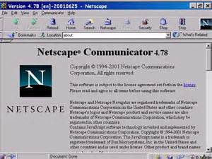
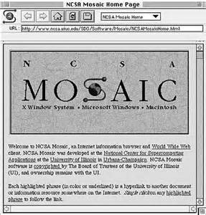
Older Browsers

Slide 9
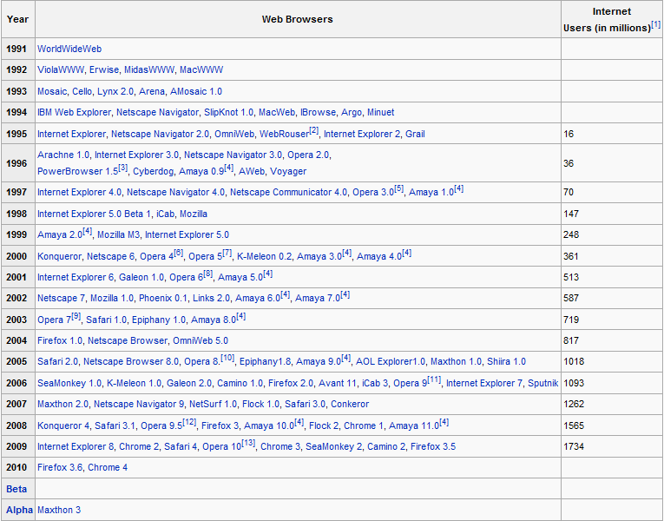
Web Browsers

Slide 10
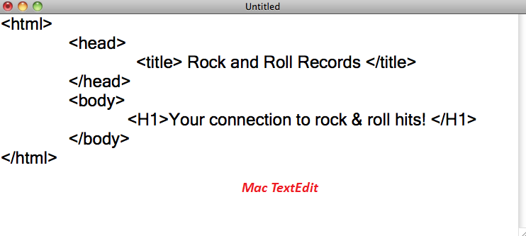
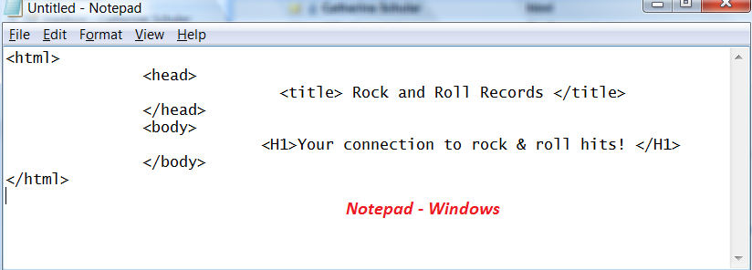
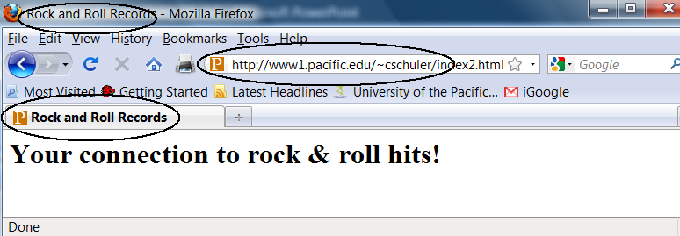
HTML Sample

Slide 11
Using Tags
HTML Documents are “marked up” using tags:
  This word is <b> important </b>!
  <h1> This is a heading </h1>
Most tags come in pairs (start and end)
Tags are NOT case sensitive
Written in Plain Text
Start Tag
End Tag

Slide 12
Marking Up a Page (formatting)
Style
  Font and Size
  Color
  Margins
Layout
  Columns
  Tables
Images
  Logos
  Pictures
  Backgrounds
  Buttons
Links
  other pages
  documents, etc

Slide 13
HTML Page Setup
HTML Pages should follow this standard:
<html>
<head>
<title> Page Title </title>
</head>
<body>
...
</body>
</html>

Slide 14
DOCTYPE
The <!DOCTYPE> declaration is not an HTML tag; it is an instruction to the web browser about what version of HTML the page is written in.
Depends on version
  <!DOCTYPE HTML PUBLIC "-//W3C//DTD HTML 4.01 Transitional//EN" "http://www.w3.org/TR/html4/loose.dtd">
  <!DOCTYPE html>

Slide 15
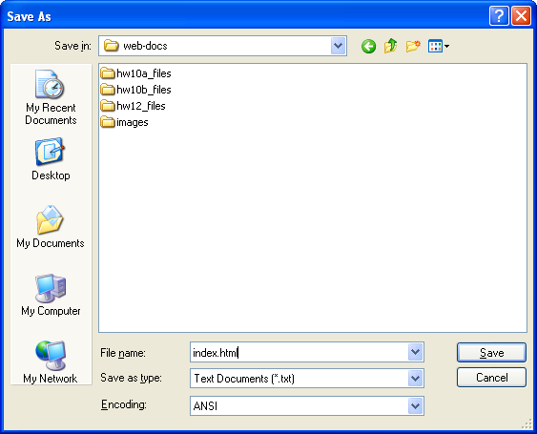
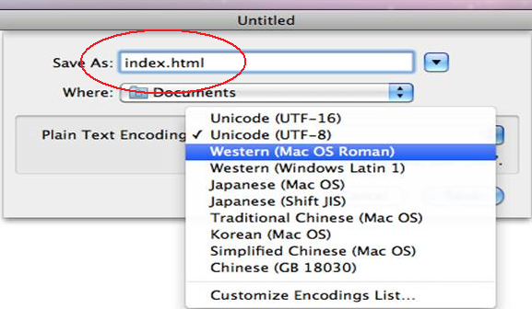
Saving Files as HTM or HTML
All html documents are “pure text”
The browser recognizes pages that end in .htm or .html as web pages
Be sure to type full file name in Notepad or Text Edit: index.html – or else it will default to index.txt

Slide 16
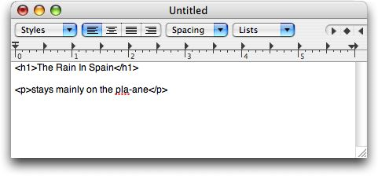
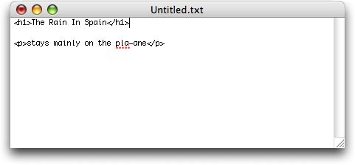
Mac – Text Edit users:
Must follow instructions from Resources link to properly configure TextEdit to function in pure text mode, not formatted view.
Do this BEFORE you start coding or saving pages
RESOURCES

Slide 17
index.html
As a rule, the "first" page of all websites are always called "index.html"
The web server knows to find this page first and send it to the browser, unless a specific page was requested.

Slide 18

index.html is Page 1
index.html
products.html
about.html
investorrelations.html
links.html

Slide 19
File Naming
web-docs folder is on a Unix O/S
File naming rules are different than Windows
Unix is case-sensitive and doesn’t like spaces.
Save all files as lowercase, no spaces
index.html apple.jpg links.html

Slide 20
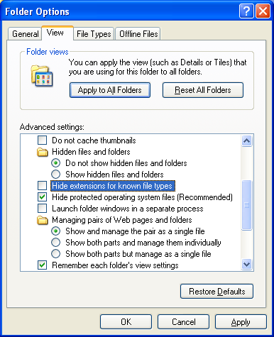
Prep: Reveal File Extensions
My Computer
  Tools | Folder Options or Organize | Folder and Search Options
View
Uncheck “Hide extensions for known filetypes”
OK/Apply

Slide 21
File Extension Troubles:
index
index.html
index.HTML
puppy
puppy.JPG
puppy.jpg

Slide 22
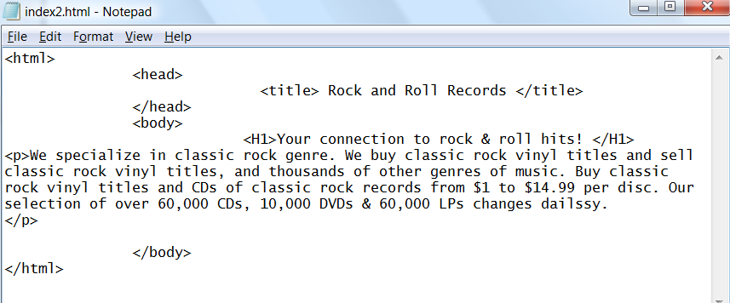
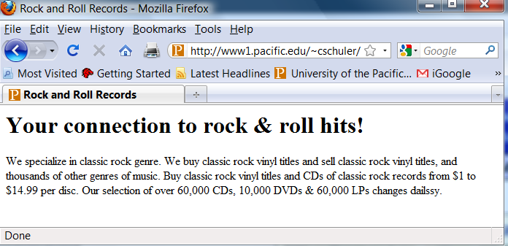
To Edit HTML
Open Source file
Edit file -- SAVE -- Refresh in Browser
Or Click EDIT in webfolders.pacific.edu

Slide 23
Basic Tags for Lab/Homework
<h1> Heading 1 (use 1-6)
<p> Paragraph
<br> *Break Line
<b> Bold
<i> Italic
<u> Underline
<hr> *Horizontal Rule
<div> Division/Section

Slide 24
Creating Lists (Bulleted)
<ul> Unordered List
  <li> List Item </li>
  <li> List Item </li>
  <li> List Item </li>
</ul>
<ol> Ordered List (instead of ul)

Slide 25
Tips on Tags
Tags usually have a beginning and an end
Indenting and spacing will keep you sane
Filenames and URLs are almost always case-sensitive.
Tags are not case sensitive

Slide 26
Try Some Tags!
<b>Text</b>
<i>Text</i>
<hr>
<h1>This is a heading</h1>
<h2>This is a subheading</h2>

Slide 27
Editing Files in U:\web-docs
If you are not connected directly to a University computer:
  webfolders.pacific.edu
  WinScp (PC)
  Fetch (Mac)

Slide 28
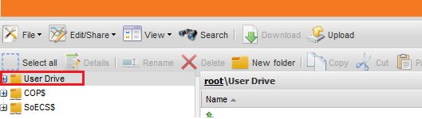
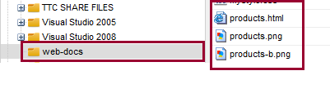
WebFolders: web-based FTP view
webfolders.pacific.edu
User Drive
web-docs folder

Slide 29
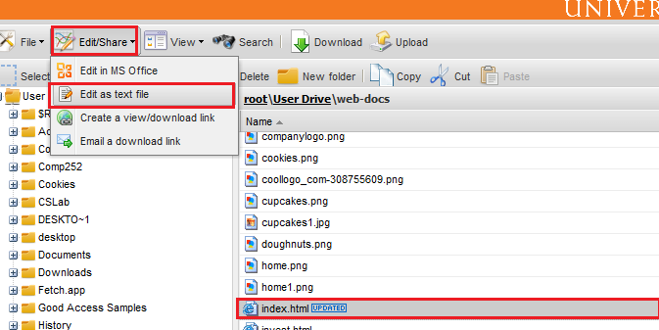
Editing files in web-docs
Click on any TEXT file (.html/.css)
Click: Edit/Share
Click: Edit as text file

Slide 30
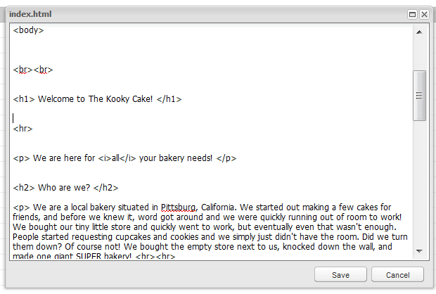
Make changes/edit
Make Changes
Save
Changes
are saved
to server
Refresh
page

Slide 31
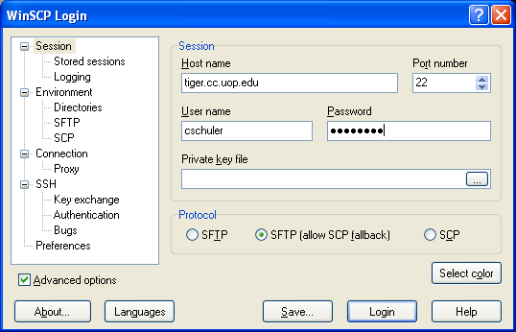
WinScp3: tiger.cc.uop.edu

Slide 32
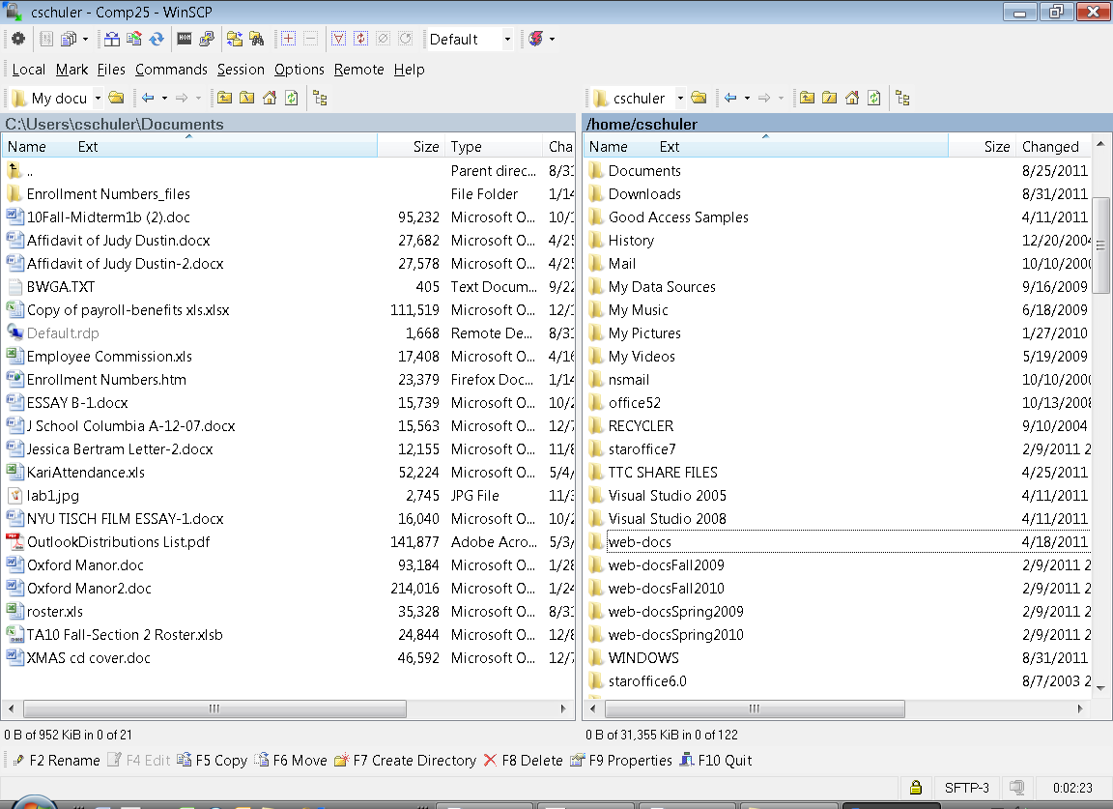
WinScp3 Host - Remote

Slide 33
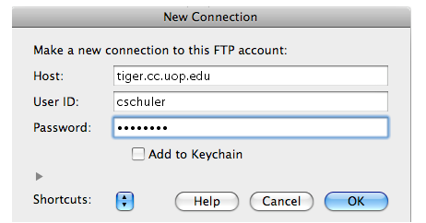
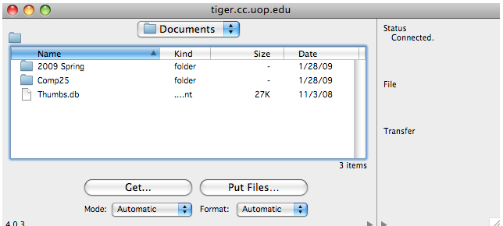
Mac: Using Fetch

Slide 34

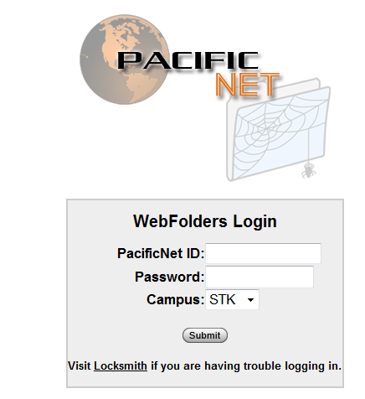
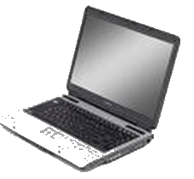

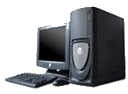

Where am I?
U:\web-doc
UNIX servers
Mac & PC
PC
Laptop or home computer
NOT connected to U:\ drive
Lab computers
Library computers
Connected directly to U:\web-docs
Mac

Slide 35
Notes on Privacy: Meta Tags
Your pages “live” on a public web server and will be indexed in Google if you don’t add tags in <HEAD> area to instruct the auto bots not to index. Only if you do not want to be indexed, use the following tags:
<head>
<meta name="googlebot" content="noarchive">
<meta name="googlebot" content="noindex">
<meta name="robots" content="noindex">
<meta name="robots" content="nofollow">
<title>Gigi's</title>
</head>

Slide 36
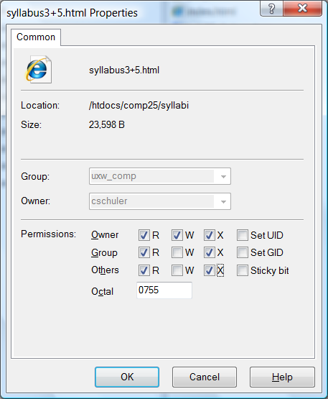
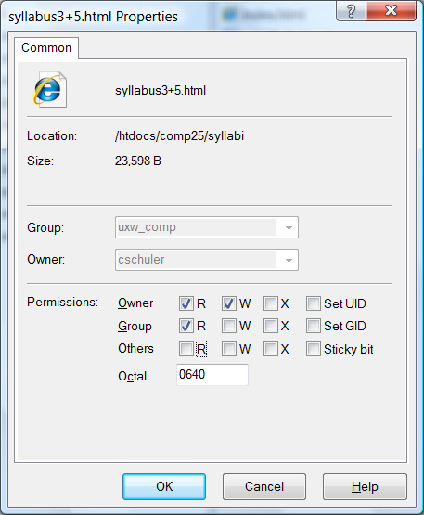
Forbidden Pages – UNIX permissions
UNIX files have permissions assigned to all files:
During FTP session, permissions may become lost
Reset in WinSCP 4

Slide 37
What About Style?
In modern website design, HTML tags are only used to “structure” the document – to show headings, paragraphs, lists, etc.
A special system called Style Sheets are used to describe how tags appear. That’s coming soon.

